Slide 1
Dining Philosophers and the Deadlock Concept

Slide 2
Dining Philosophers
A problem that was invented to illustrate a different aspect of communication
Our focus here is on the notion of sharing resources that only one user at a time can own
  Such as a keyboard on a machine with many processes active at the same time
  Or a special disk file that only one can write at a time (bounded buffer is an instance)

Slide 3

Dining Philosopher’s Problem
Dijkstra
Philosophers eat/think
Eating needs two forks
Pick one fork at a time
Idea is to capture the concept of multiple processes
competing for limited resources

Slide 4
Rules of the Game
The philosophers are very logical
  They want to settle on a shared policy that all can apply concurrently
  They are hungry: the policy should let everyone eat (eventually)
  They are utterly dedicated to the proposition of equality: the policy should be totally fair

Slide 5
What can go wrong?
Primarily, we worry about:
  Starvation: A policy that can leave some philosopher hungry in some situation (even one where the others collaborate)
  Deadlock: A policy that leaves all the philosophers “stuck”, so that nobody can do anything at all
  Livelock: A policy that makes them all do something endlessly without ever eating!

Slide 6
Starvation vs Deadlock
Starvation vs. Deadlock
  Starvation: thread waits indefinitely
    Example, low-priority thread waiting for resources constantly in use by high-priority threads
  Deadlock: circular waiting for resources
    Thread A owns Res 1 and is waiting for Res 2
    Thread B owns Res 2 and is waiting for Res 1
  Deadlock ⇒ Starvation but not vice versa
    Starvation can end (but doesn’t have to)
    Deadlock can’t end without external intervention
Thread
A
Wait
For
Owned
By
Res 1
Res 2
Owned
By
Wait
For
Thread
B

Slide 7
A flawed conceptual solution
# define N 5
Philosopher i (0, 1, .. 4)
do {
think();
take_fork(i);
take_fork((i+1)%N);
eat(); /* yummy */
put_fork(i);
put_fork((i+1)%N);
} while (true);

Slide 8
Coding our flawed solution?
Shared: semaphore fork[5];
Init: fork[i] = 1 for all i=0 .. 4
Philosopher i
do {
P(fork[i]);
P(fork[i+1]);
/* eat */
V(fork[i]);
V(fork[i+1]);
/* think */
} while(true);
Oops! Subject to deadlock if they all pick up their “right” fork simultaneously!

Slide 9
Dining Philosophers Solutions
Allow only 4 philosophers to sit simultaneously
Asymmetric solution
  Odd philosopher picks left fork followed by right
  Even philosopher does vice versa
Pass a token
Allow philosopher to pick fork only if both available

Slide 10
One Possible Solution
Introduce state variable
  enum {thinking, hungry, eating}
Philosopher i can set the variable state[i] only if neighbors not eating
  (state[(i+4)%5] != eating) and (state[(i+1)%5]!= eating
Also, need to declare semaphore self, where philosopher i can delay itself.

Slide 11
One possible solution
Shared: int state[5], semaphore s[5], semaphore mutex;
Init: mutex = 1; s[i] = 0 for all i=0 .. 4
take_fork(i) {
P(mutex);
state[i] = hungry;
test(i);
V(mutex);
P(s[i]);
}
put_fork(i) {
P(mutex);
state[i] = thinking;
test((i+1)%N);
test((i-1+N)%N);
V(mutex);
}
Philosopher i
do {
take_fork(i);
/* eat */
put_fork(i);
/* think */
} while(true);
test(i) {
if(state[i] == hungry
&& state[(i+1)%N] != eating
&& state[(i-1+N)%N != eating)
{
state[i] = eating;
V(s[i]);
}

Slide 12
Solutions are less interesting than the problem itself!
In fact the problem statement is why people like to talk about this problem!
Rather than solving Dining Philosophers, we should use it to understand properties of solutions that work and of solutions that can fail!

Slide 13
Cyclic wait
For example… consider a deadlock
  Each philosopher is holding one fork
  … and each is waiting for a neighbor to release one fork
We can represent this as a graph in which
  Nodes represent philosophers
  Edges represent waiting-for

Slide 14

Cyclic wait

Slide 15
Cyclic wait
We can define a system to be in a deadlock state if
  There exists ANY group of processes, such that
  Each process in the group is waiting for some other process
  And the wait-for graph has a cycle
Doesn’t require that every process be stuck… even two is enough to say that the system as a whole contains a deadlock (“is deadlocked”)

Slide 16
What about livelock?
This is harder to express
  The issue is that processes may be active and yet are “actually” waiting for one-another in some sense
  Need to talk about whether or not processes make progress
  Once we do this, starvation can also be formalized
These problems can be solved… but not today
In CS414 we’ll limit ourselves to deadlock
  Detection: For example, build a graph and check for cycles (not hard to do)
  Avoidance – we’ll look at several ways to avoid getting into trouble in the first place!

Slide 17
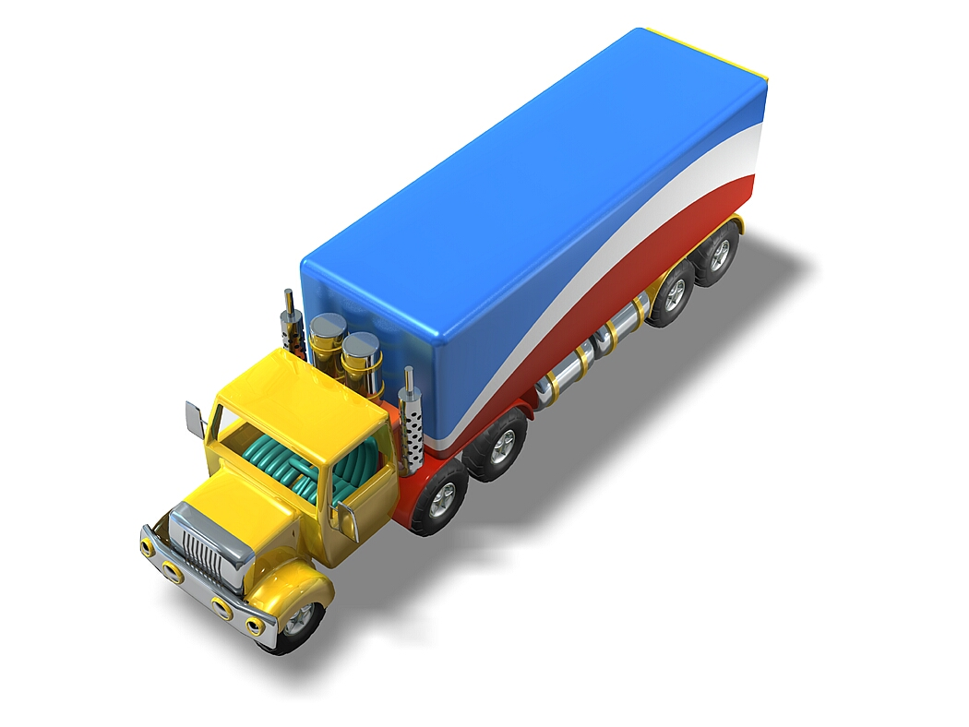
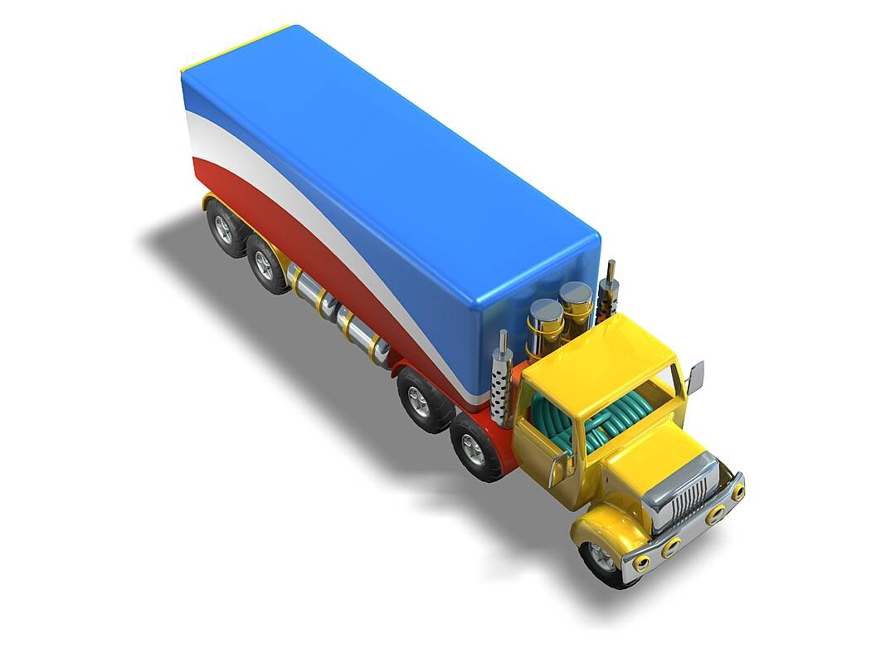
Real World Deadlocks?
Truck A has to wait
for truck B to
move
Not
deadlocked

Slide 18
Real World Deadlocks?
Gridlock

Slide 19
Real World Deadlocks?
Gridlock

Slide 20
The strange story of “priorité a droite”
France has many traffic circles…
  … normally, the priority rule is that a vehicle trying to enter must yield to one trying to exit
  Can deadlock occur in this case?
But there are two that operate differently
  Place Etoile and Place Victor Hugo, in Paris
  What happens in practice?
In Belgium, all incoming roads from the right have priority unless otherwise marked, even if the incoming road is small and you are on a main road.
  This is useful to remember.
  Is the entire country deadlock-prone?

Slide 21
Testing for deadlock
Steps
  Collect “process state” and use it to build a graph
    Ask each process “are you waiting for anything”?
    Put an edge in the graph if so
  We need to do this in a single instant of time, not while things might be changing
Now need a way to test for cycles in our graph

Slide 22
Testing for deadlock
How do cars do it?
  Never block an intersection
  Must back up if you find yourself doing so
Why does this work?
  “Breaks” a wait-for relationship
  Illustrates a sense in which intransigent waiting (refusing to release a resource) is one key element of true deadlock!

Slide 23
Testing for deadlock
One way to find cycles
  Look for a node with no outgoing edges
  Erase this node, and also erase any edges coming into it
    Idea: This was a process people might have been waiting for, but it wasn’t waiting for anything else
  If (and only if) the graph has no cycles, we’ll eventually be able to erase the whole graph!
This is called a graph reduction algorithm

Slide 24
Graph reduction example
0
3
4
8
This graph can be “fully reduced”, hence there was no deadlock at the time the graph was drawn.
Obviously, things could change later!
7
2
11
1
5
9
10
12
6

Slide 25
Graph reduction example
This is an example of an “irreducible” graph
It contains a cycle and represents a deadlock, although only some processes are in the cycle

Slide 26
What about “resource” waits?
When dining philosophers wait for one-another, they don’t do so directly
  Erasmus doesn’t “wait” for Ptolemy
Instead, they wait for resources
  Erasmus waits for a fork… which Ptolemy exclusively holds
Can we extend our graphs to represent resource wait?

Slide 27
Resource-wait graphs
We’ll use two kinds of nodes
A process: P₃ will be represented as:
A resource: R₇ will be represented as:
  A resource often has multiple identical
  units, such as “blocks of memory”
  Represent these as circles in the box
Arrow from a process to a resource: “I want
k units of this resource.” Arrow to a process:
this process holds k units of the resource
  P₃ wants 2 units of R₇
3
2
7

Slide 28
A tricky choice…
When should resources be treated as “different classes”?
  To be in the same class, resources do need to be equivalent
    “memory pages” are different from “forks”
  But for some purposes, we might want to split memory pages into two groups
    The main group of forks. The extra forks
  Keep this in mind next week when we talk about ways of avoiding deadlock.
    It proves useful in doing “ordered resource allocation”

Slide 29
Resource-wait graphs
1
2
3
4
1
2
1
1
2
5
1
4

Slide 30
Reduction rules?
Find a process that can have all its current requests satisfied (e.g. the “available amount” of any resource it wants is at least enough to satisfy the request)
Erase that process (in effect: grant the request, let it run, and eventually it will release the resource)
Continue until we either erase the graph or have an irreducible component. In the latter case we’ve identified a deadlock

Slide 31
This graph is reducible: The system is not deadlocked
1
2
3
4
1
2
1
1
2
1
1
4

Slide 32
This graph is not reducible: The system is deadlocked
3
2
1
1
2
1
4
2
1
5
1
4

Slide 33
Comments
It isn’t common for systems to actually implement this kind of test
However, we’ll use a version of the resource reduction graph as part of an algorithm called the “Banker’s Algorithm” later in the week
Idea is to schedule the granting of resources so as to avoid potentially deadlock states

Slide 34
Some questions you might ask
Does the order in which we do the reduction matter?
  Answer: No. The reason is that if a node is a candidate for reduction at step i, and we don’t pick it, it remains a candidate for reduction at step i+1
  Thus eventually, no matter what order we do it in, we’ll reduce by every node where reduction is feasible

Slide 35
Some questions you might ask
If a system is deadlocked, could this go away?
  No, unless someone kills one of the threads or something causes a process to release a resource
  Many real systems put time limits on “waiting” precisely for this reason. When a process gets a timeout exception, it gives up waiting and this also can eliminate the deadlock
  But that process may be forced to terminate itself because often, if a process can’t get what it needs, there are no other options available!

Slide 36
Some questions you might ask
Suppose a system isn’t deadlocked at time T.
Can we assume it will still be free of deadlock at time T+1?
  No, because the very next thing it might do is to run some process that will request a resource…
    … establishing a cyclic wait
    … and causing deadlock

